Slide 1
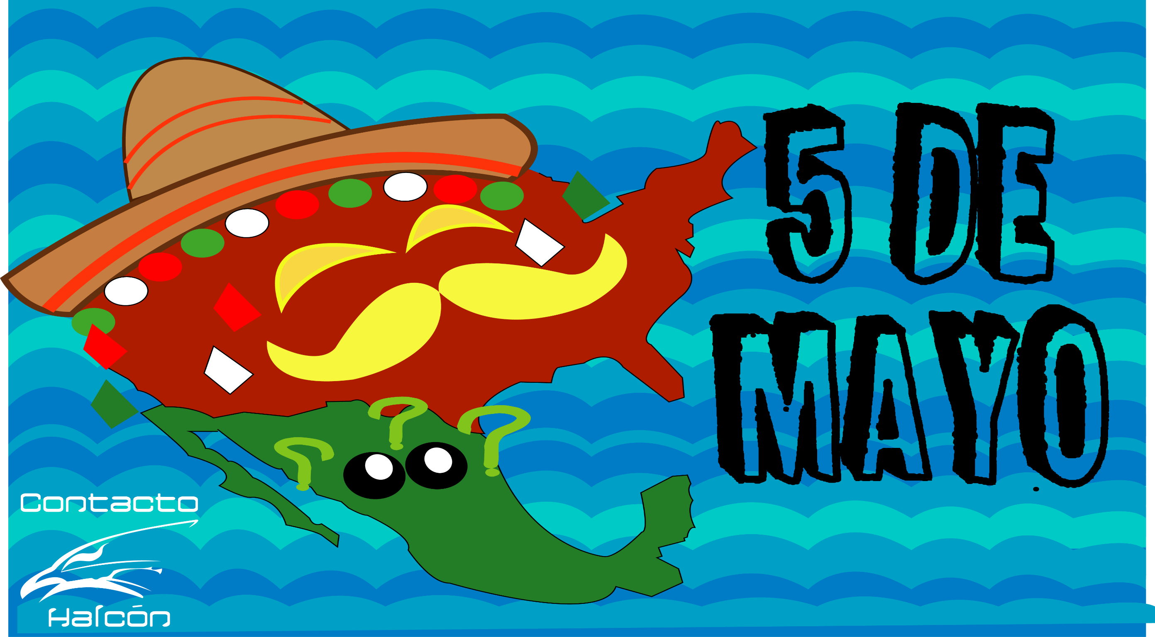

Slide 2
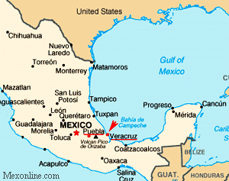

Slide 3
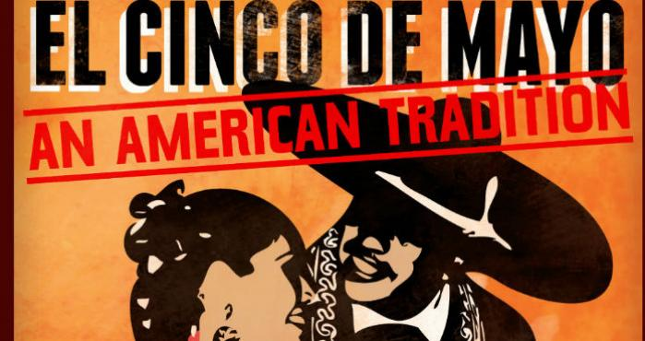
¿Por qué se celebra el 5 de mayo en Estados Unidos de América?

Slide 5
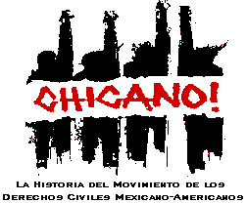
The Chicano Movement of the 1960s, also called the Chicano Civil Rights Movement or El Movimiento, was a civil rights movement extending the Mexican American Civil Rights Movement of the 1960s with the stated goal of achieving Mexican American empowerment.

Slide 6
¿Qué significa Chicano o Chicana?
Mexicano- Americano nacido en E.U.A. y vive en E.U.A.
Chicano or Chicana is a chosen identity of some Mexican Americans in the United States. They are Mexican born in the U.S.A. and live in U.S.A.
Both names are chosen identities within the Mexican-American community in the United States.

Slide 7
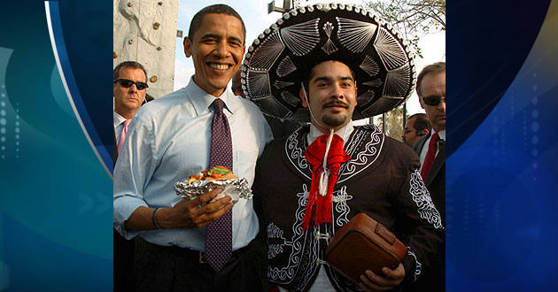
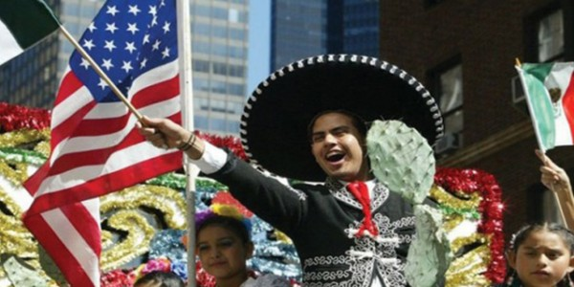
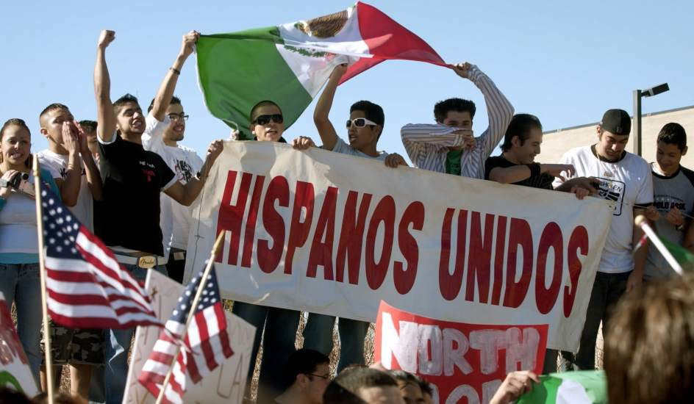
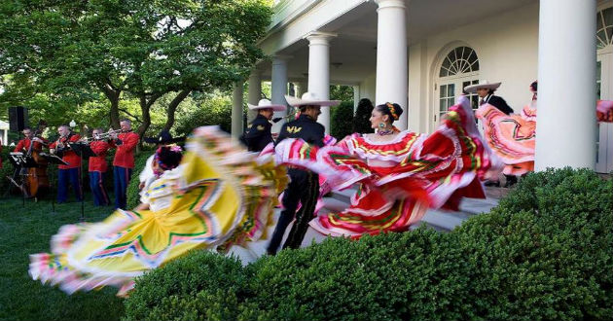

Slide 8
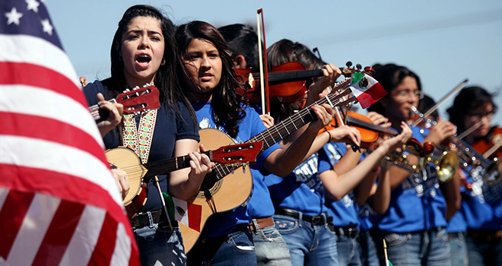
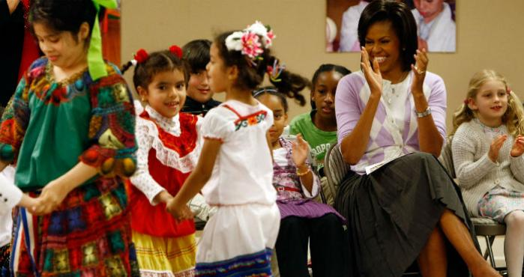

Slide 9
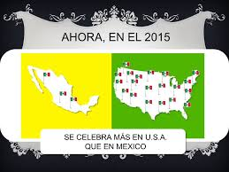
Nowadays, the celebration of ¨5 de mayo¨ is celebrated more in U.S.A. than in Mexico.

